Slide 1


Predicting Housing Market Trends: A Data-Driven Approach to Price Forecasting
Presented By :- Amarnath Kommineni Kavya Gurram Sandeep Borwal Vikas Kumar Reddy Buchammagari

Slide 2
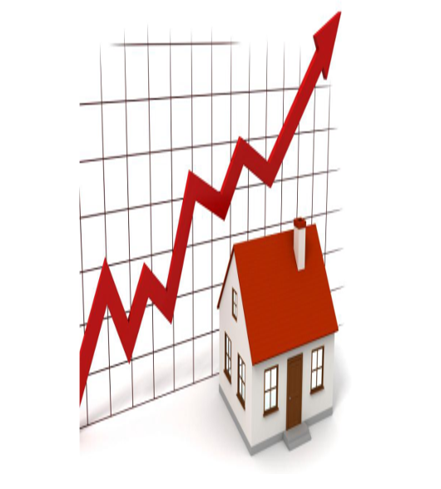
Predicting Housing Prices Using Machine Learning
Introduction
The real estate market significantly impacts the global economy.
Housing prices depend on multiple factors like location, size, and market trends.
Traditional pricing methods are subjective, time-consuming, and prone to errors.
Problem Statement
Estimating property values accurately remains a challenge.
Various factors, including property features and external conditions, influence prices.
Current appraisal methods lack efficiency and objectivity.
Solution: Machine Learning Model
Leverages historical data to identify patterns and correlations.
Improves accuracy by reducing human bias in price estimation.
Provides quick, data-driven predictions based on market conditions.
Project Goal
Develop a machine learning model to predict housing prices.
Use key property attributes and economic indicators for training.
Enhance reliability and efficiency in real estate pricing.

Slide 3
Where are we?
Data Collection & Cleaning: Gather structured and unstructured property data.
Exploratory Data Analysis (EDA): Identify trends and correlations.
Model Development: Train various ML models (regression, ensemble methods, deep learning).
Finalize Model,
Report
Identify best model , refine model , retrain models
Model Evaluation & Optimization: Use RMSE, MAE, and R-squared to assess accuracy.

Slide 4
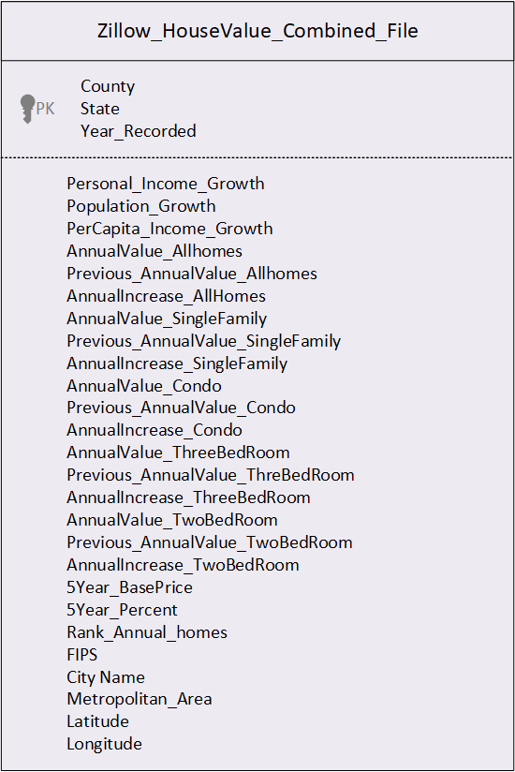

Zillow House Price Model Dataset
Notes:
As part of Exploratory Data Analysis ; we read the Zillow Home Value Index data sets for AllHomes, Single Family , Condo, TwoBedRoom, ThreeBedRoom .
Build Annual Increase for each of County for each Year.
Build 5 Year Increase for each of County for each Year.
Idnetified Personal income Growth , Population Growth , Percapita Income Growth for each county to every year . Performed Percapita Increase from year to Year.
Build Rank for each County and performed Exploratory Data Analysis and produced Combined Dataset.

Slide 5
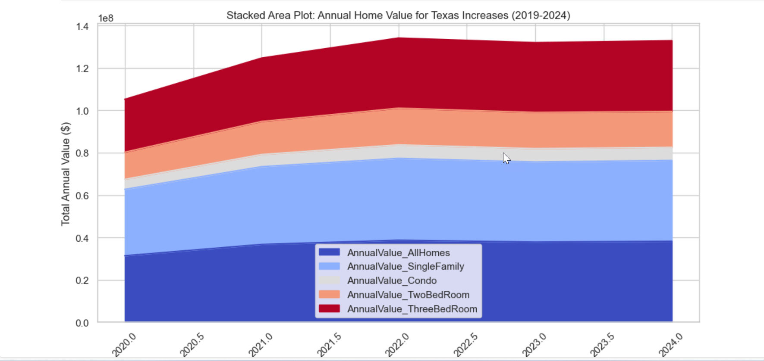
EDA Analysis - House Values across all Categories over Years

Slide 6

Machine Learning Workflow for Real Estate Forecasting
Impute the missing Data
Missing data for Population Growth, Personal Income Growth, Per Capita Income Growth, and Previous Annual Values in some counties.
If data is available for the next year, impute missing values as 90% of the next year's value.
If no data exists in the next year, impute using the mean value for the State-County combination.
Identify and remove outliers using statistical methods (IQR, Z-score).
Build Machine Learning Models
Build Machine Learning Models using Percapita, Population Growth , Personal Income Growth, Previous Annual Value, Annual Value, Annual Percent Increase for each Year.
Build Train and Test Data. Train Data will be used for all other Years other than 2024 data.
Test Data set will be used with 2024 Year and mark it as for Year 2025.
Convert Categorical Features to Numeric using one-hot encoding .
Perform Cross Fold Validations
Limited categorical variables affecting regional property insights.
Gaps in time-series data requiring interpolation.
Aggregation mismatches between county-level and zip-code-level data.
Evaluate the Results
Identify RMSE , MAE, Train Accuracy , Test Accuracy for each Model Output.
Based on the results identify best Model will be output.
Identify Features that has Highest Importance.
Assumptions Made
Missing numerical values assumed to follow similar distributions.
Min-max scaling applied for feature normalization.
Assumed property trends represent market behaviour without external influences.

Slide 7
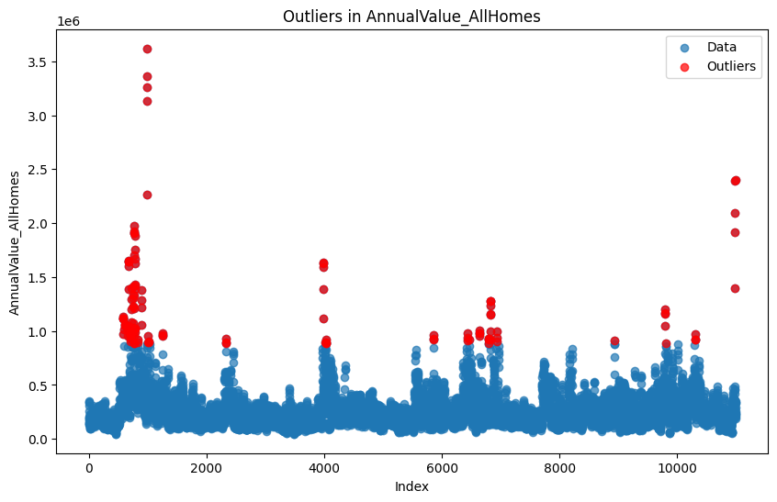
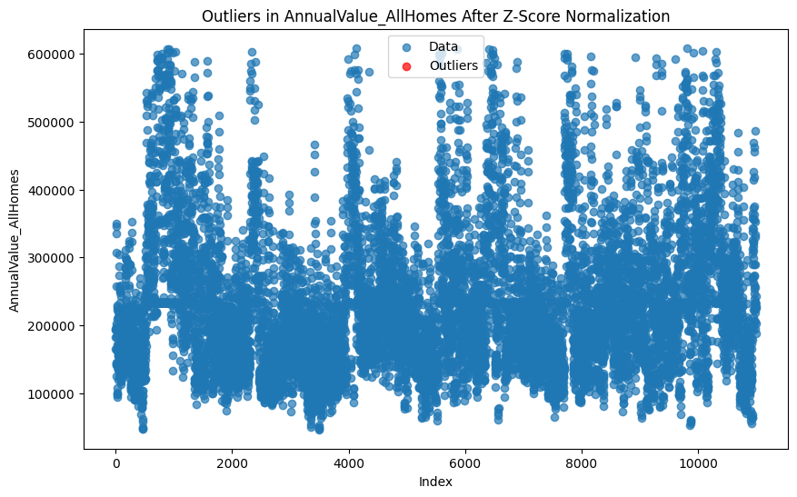
Identify and Replace Outliers.
Identify the outliers in the data. Outliers are determined using the Interquartile Range (IQR) of house values. The IQR is calculated between the 25th percentile (Q1) and the 75th percentile (Q3) of the data.
Outliers are defined as values falling outside the lower and upper bounds:
Lower bound = Q1 - 1.5 * IQR
Upper bound = Q3 + 1.5 * IQR
Here, 1.5 is a commonly used multiplier in the outlier detection process and is known as the "outlier coefficient." It is applied to the IQR to define the threshold beyond which data points are considered outliers.
Remove Outliers using Z-Score Normalization . Calculate Z-Score and replace with mean on Z-Scores > 2 and < -2 .

Slide 8
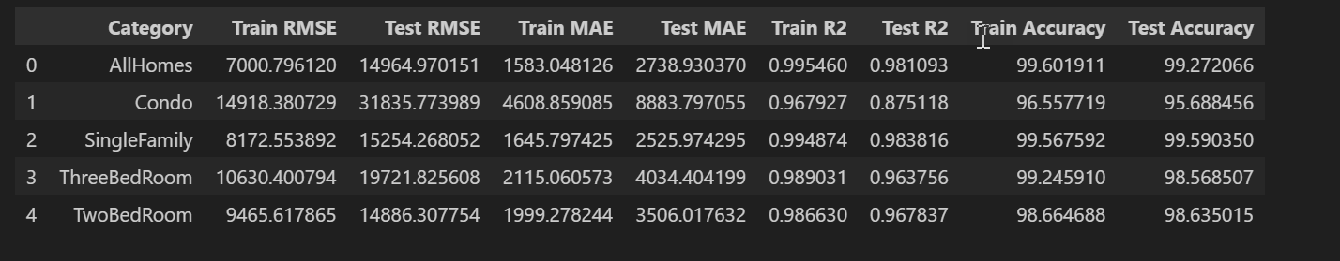
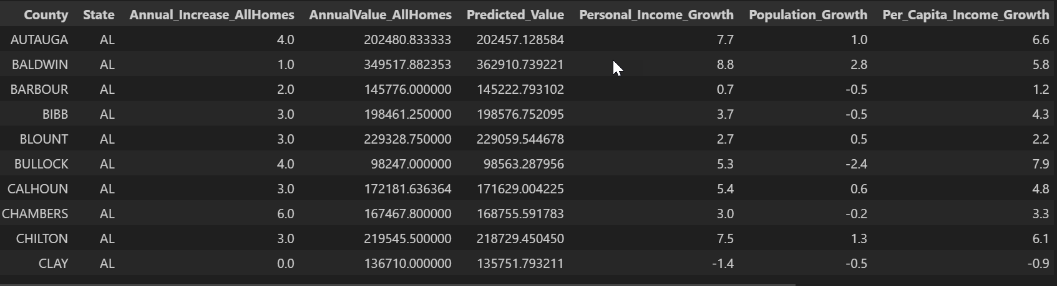
Random Forest
For real estate prediction, Random Forest excels at modeling complex non-linear relationships between features, handling interactions between location and economic indicators, managing outliers in housing data, and capturing both local and regional market trends.
Major advantages include handling large datasets with many features, resistance to overfitting, automatic feature importance ranking, and compatibility with both numerical and categorical variables.
Key Findings:
Very high accuracy across all property categories (95-99%)
Excellent R² values (0.87-0.98) indicating strong predictive power
Performance is particularly strong for SingleFamily homes
The model effectively handles different property types with varied characteristics
Test Metrics
Notes:
Random Forest for Regression uses Random Forest Regressor

Slide 9
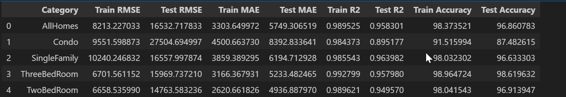
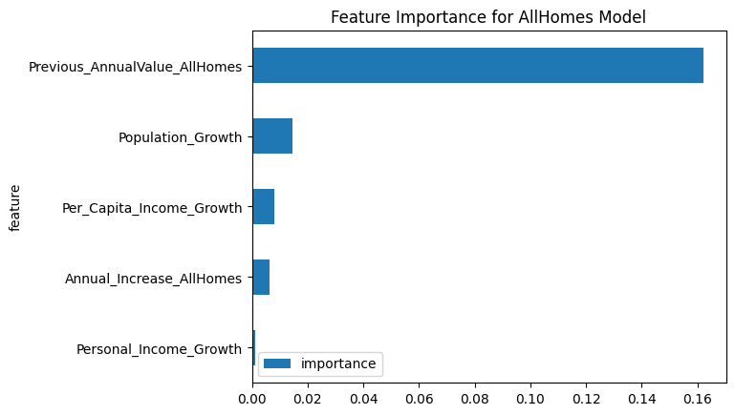
XGBOOST
XGBoost (Extreme Gradient Boosting) is a powerful machine learning algorithm that is part of the gradient boosting family. XGBoost builds an ensemble of decision trees, where each new tree corrects the errors made by the previous trees. This is done through a technique called gradient boosting, which optimizes a model by iteratively adding new trees that minimize the residual error from previous iterations.
XGBOOST helps for House Price Predictions that involves complex non linear relationships b/w attributes.
XGBoost helps prevent overfitting data. It can handle outliers easily . XGBoost is robust to such outliers because it builds decision trees iteratively and focuses on minimizing errors rather than overfitting to extreme values.
XGBoost can handle missing values during training with out imputation.
XGBoost uses Depth First training instead of Breadth-First which helps model accuracy.
XGBoost has various hyperparameters (e.g., learning rate, number of estimators, maximum depth, etc.) that are ine-tuned to improve model performance. This allows it to fit the house price prediction model optimally.
xgb.XGBRegressor( subsample=0.8, n_estimators=100, max_depth=6, learning_rate=0.1, gamma=0, colsample_bytree=0.8, random_state=42 )
XGBOOST plots the Feature Importance across Model Build which help explain the importance of each feature in making a prediction.
Notes:
subsample=0.8: Uses 80% of the training data for each tree to reduce overfitting.
n_estimators=100: Builds 100 trees (or boosting rounds) in the model.
max_depth=6: Sets the maximum depth of each tree to 6 levels, balancing model complexity.
learning_rate=0.1: Controls how much each tree influences the model, with smaller values requiring more trees.
gamma=0: No additional regularization is applied to the tree-building process.
colsample_bytree=0.8: Uses 80% of the features to build each tree, helping to prevent overfitting.
random_state=42: Ensures reproducibility of results.

Slide 10
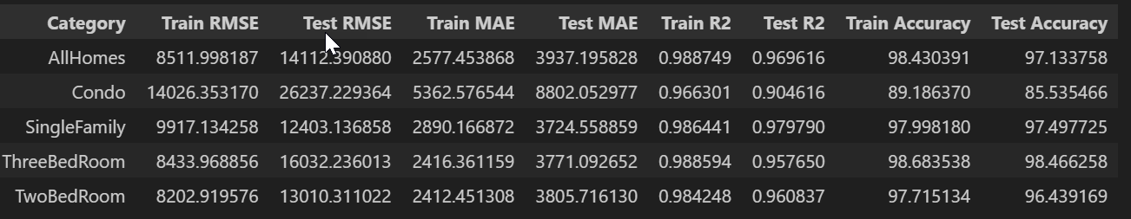
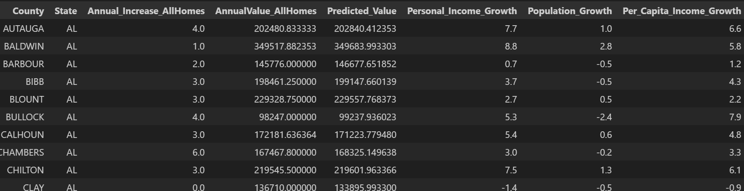
Light Boost
LGBM (Light Gradient Boosting Machine) –
LGBM (Light Gradient Boosting Machine) is a powerful machine learning algorithm in the gradient boosting family, similar to XGBoost.
It builds an ensemble of decision trees iteratively, where each tree corrects errors from the previous one.
Unlike XGBoost, which uses depth-first growth, LightGBM grows trees leaf-wise, selecting the leaf with the highest loss reduction.
This leaf-wise approach results in more accurate models with fewer trees.
LightGBM natively handles categorical features, unlike XGBoost, which requires manual encoding.
It employs histogram-based algorithms, bucketing continuous features into discrete bins for faster training on large datasets while maintaining accuracy.
LightGBM’s efficient categorical feature handling reduces preprocessing efforts, such as one-hot encoding
Notes:
subsample=0.8: Uses 80% of the training data for each tree to reduce overfitting.
n_estimators=100: Builds 100 trees (or boosting rounds) in the model.
max_depth=6: Sets the maximum depth of each tree to 6 levels, balancing model complexity.
learning_rate=0.1: Controls how much each tree influences the model, with smaller values requiring more trees.
gamma=0: No additional regularization is applied to the tree-building process.
colsample_bytree=0.8: Uses 80% of the features to build each tree, helping to prevent overfitting.
random_state=42: Ensures reproducibility of results.

Slide 11
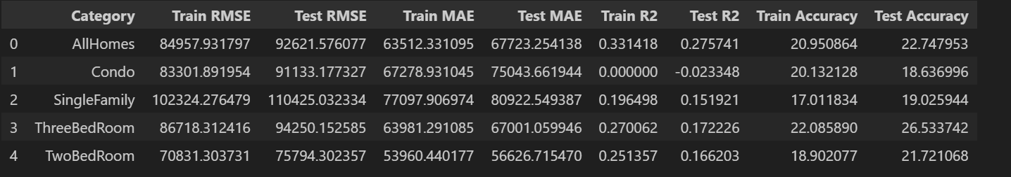
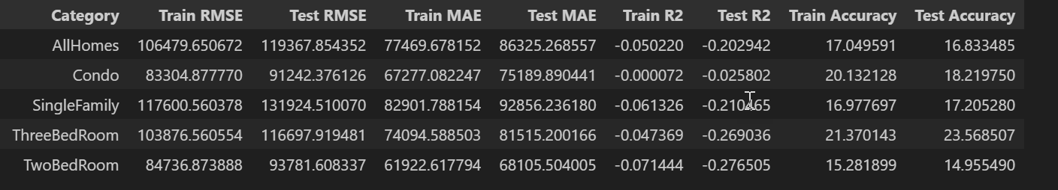
Lasso and SVR
Lasso Results
LASSO stands for Least Absolute Shrinkage and Selection Operator.
LASSO performs both feature selection and regularization in order to enhance the prediction accuracy and interpretability of the resulting model.
Regularization refers to the technique of adding a penalty term to the objective function during training to prevent overfitting and improve generalization performance.
LASSO uses L1 Regularization. L1 penalty shrinks the coefficients of less important variables towards zero, effectively removing them from the model and simplifying it LGBM uses LGBM Regressor.
Support Vector Regression (SVR) is a machine learning technique used for regression tasks. It is a variant of Support Vector Machines (SVM) and is designed to predict continuous numeric values.
aims to find a function that predicts a continuous target variable while maximizing the margin between the predicted values and the actual data points.
SVR identifies a “margin” around the predicted regression line, and its goal is to fit the line within this margin while minimizing the prediction error SVR uses Standard Scaler function
SVR Results
Notes:
lgbm_model = LGBMRegressor(
subsample=0.8,
n_estimators=100,
max_depth=6,
learning_rate=0.1,
random_state=42
)

Slide 12
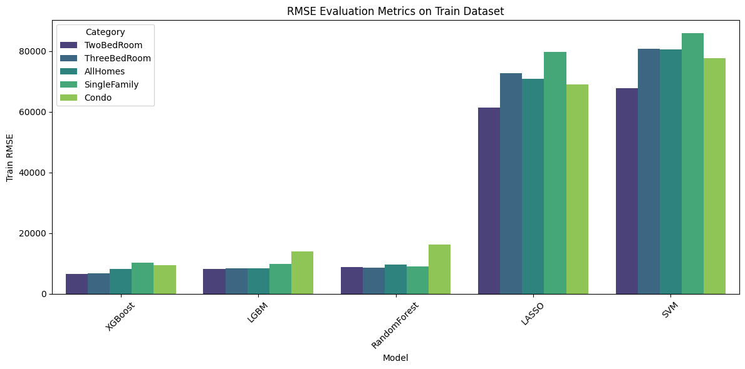
Model Evaluation on Train Data

Slide 13
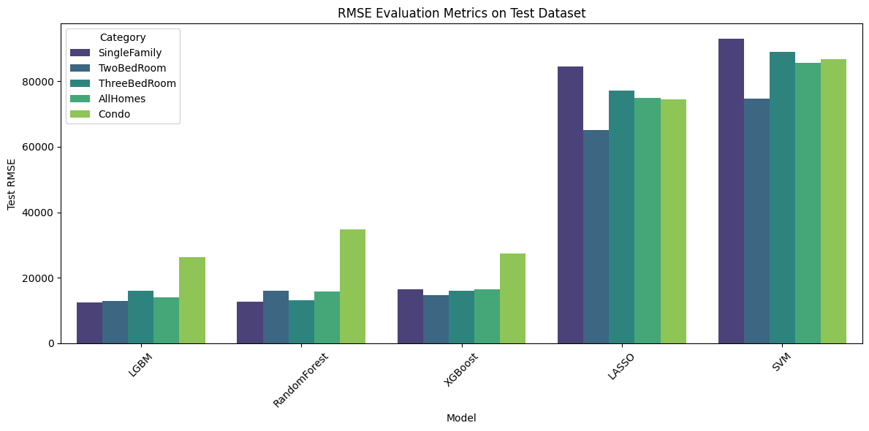
Model Evaluation on Test Data

Slide 14
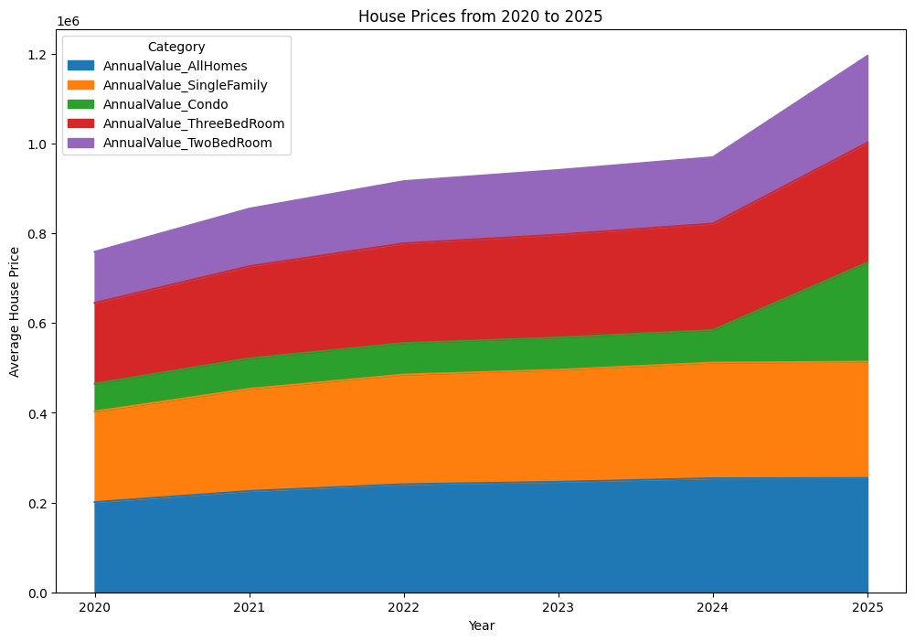
Predictions including 2020 to 2025 across all categories

Slide 15
Conclusion
Overview of the Project
Predict housing market prices using machine learning techniques.
Traditional property valuation methods are often inefficient and subjective.
Dataset Preprocessing:
Handling missing values using imputation techniques.
Identifying and removing outliers using IQR and Z-score normalization.
Encoding categorical features for model compatibility.
Machine Learning Models Implemented:-
XGBoost (Extreme Gradient Boosting) LightGBM (Light Gradient Boosting Machine)
Lasso Regression Support Vector Regression (SVR)
Model performance was evaluated using RMSE, MAE, and accuracy scores.
Key Findings
Machine learning significantly improves housing price predictions compared to traditional methods.
XGBoost outperformed other models, handling non-linear relationships effectively and managing missing values without imputation.
Implications
The model provides a more objective and data-driven approach to property valuation.
Helps real estate professionals, investors, and policymakers make better decisions based on market conditions.

Slide 16
Future Work
Revisit to Identify the Best Model, Refine Model, and Retrain Models
Compare the performance of multiple machine learning models (XGBoost, LightGBM, SVR, Lasso) to identify the best one.
Fine-tune hyperparameters for optimal performance and train ensemble models for better generalization.
Test XGBoost with Error as a Model and Evaluate Accuracy Improvement
Train a meta-model using XGBoost residual errors to enhance overall prediction accuracy.
Experiment with different loss functions (Huber loss, Tweedie loss) to reduce outlier impact.
Compare model performance before and after error-based adjustments.
Implement XGBoost + ARMA to Reduce Error Component
Combine XGBoost with ARMA (AutoRegressive Moving Average) to model and correct residual errors.
ARMA will capture time-series dependencies in housing price fluctuations, helping smooth predictions.
This hybrid approach will improve accuracy by reducing residual errors left unaddressed by XGBoost alone.
Evaluate improvements by comparing performance metrics before and after integrating ARMA.

